Slide 1
Calculating the mode
Task A: Mode from a frequency table
What is the mode for each frequency table? If there is no mode, write no mode.
Animal | Frequency
cat | 24
dog | 18
fish | 11
rabbit | 15
Goals | Frequency
0 | 16
1 | 24
2 | 24
3 | 19
Score | Frequency
1 | 12
2 | 12
3 | 12
4 | 12
cat
1 and 2 goals
no mode
A data set of 50 is represented on this frequency table.
Fill in the missing frequency and write down the mode number of goals scored.
Goals | Frequency
0 | 9
1
2 | 11
3 | 21
9
3 goals scored

Slide 2
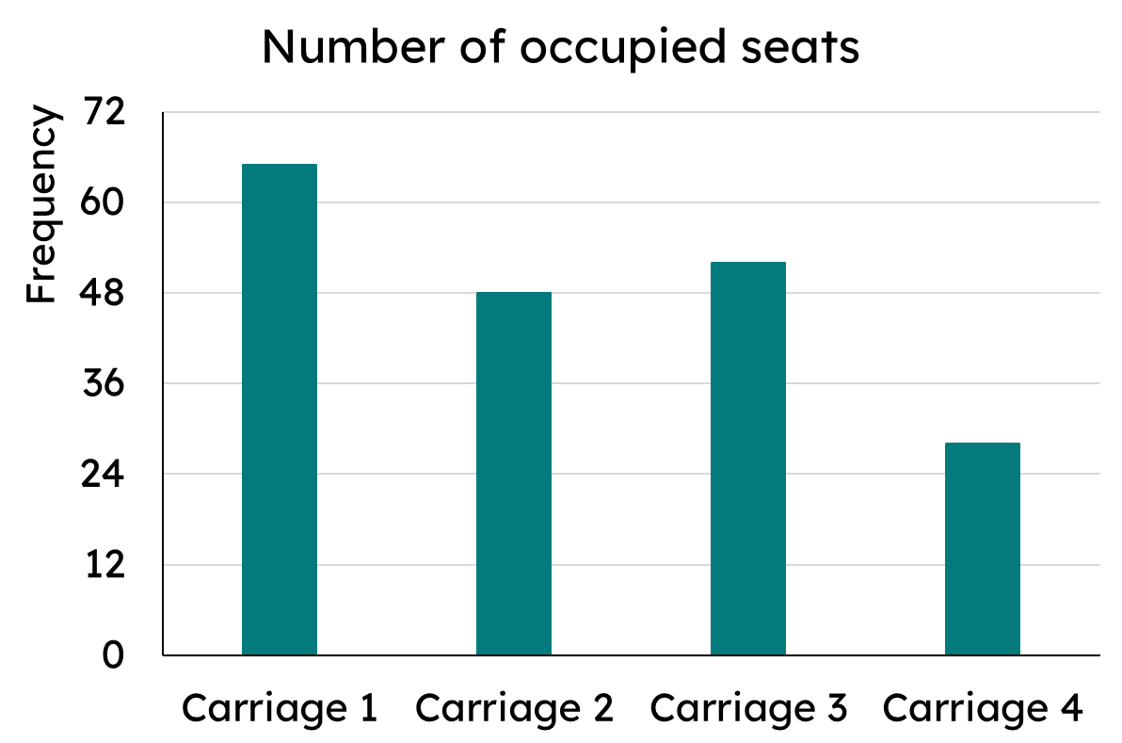
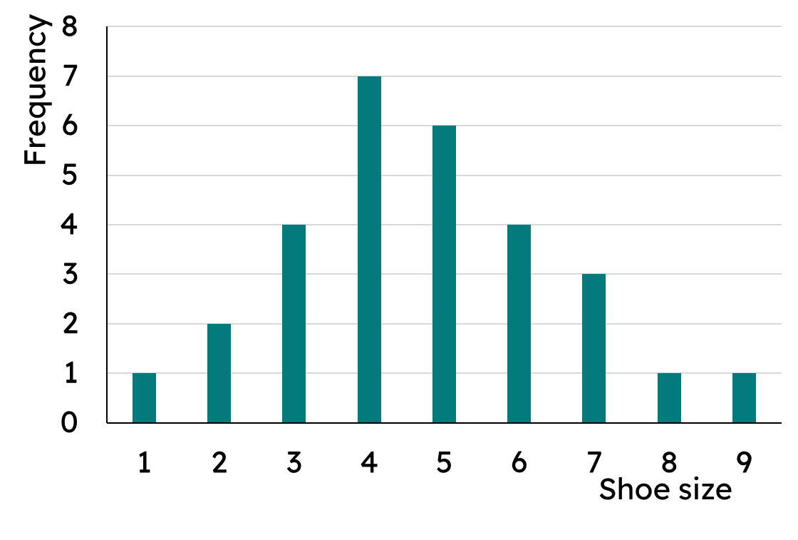
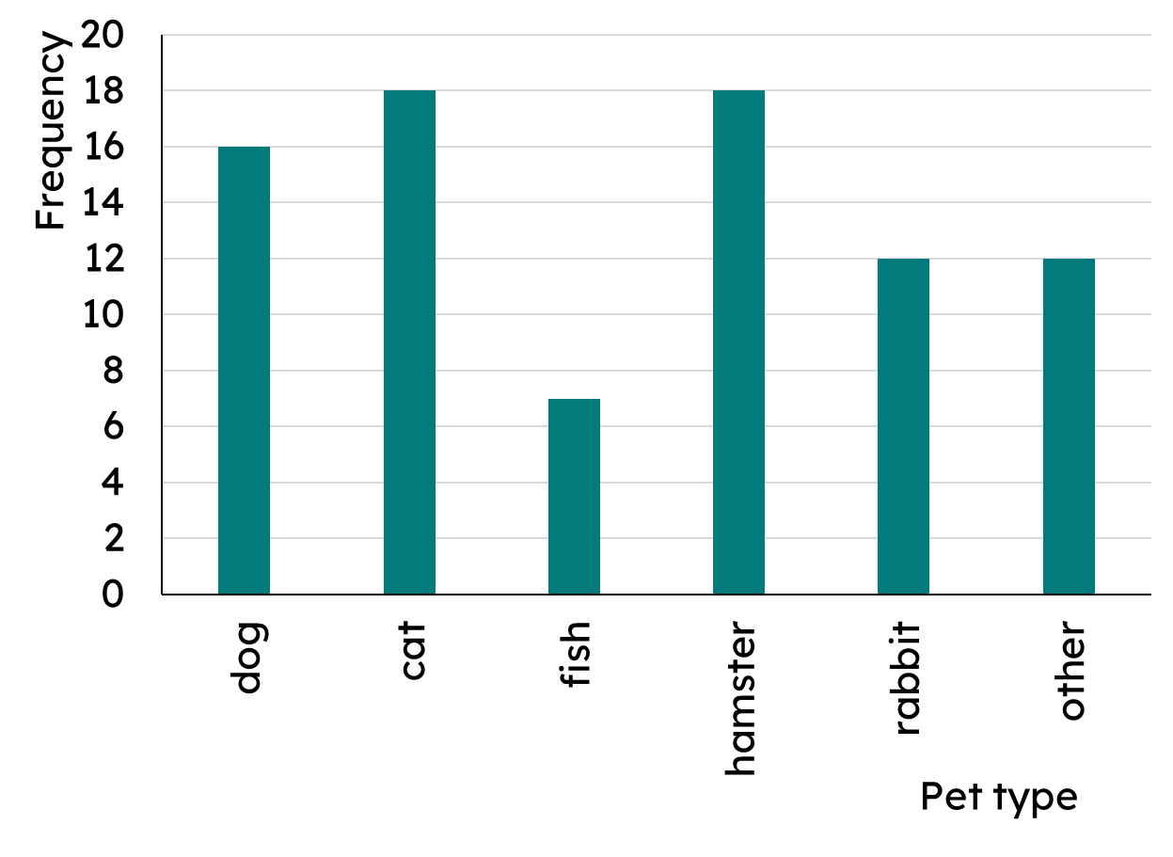
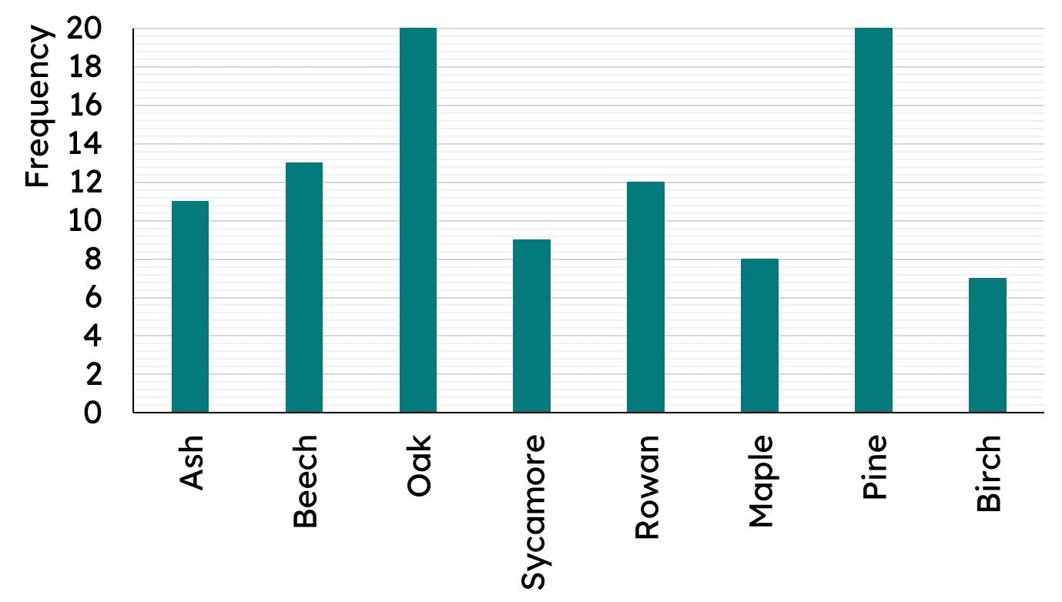
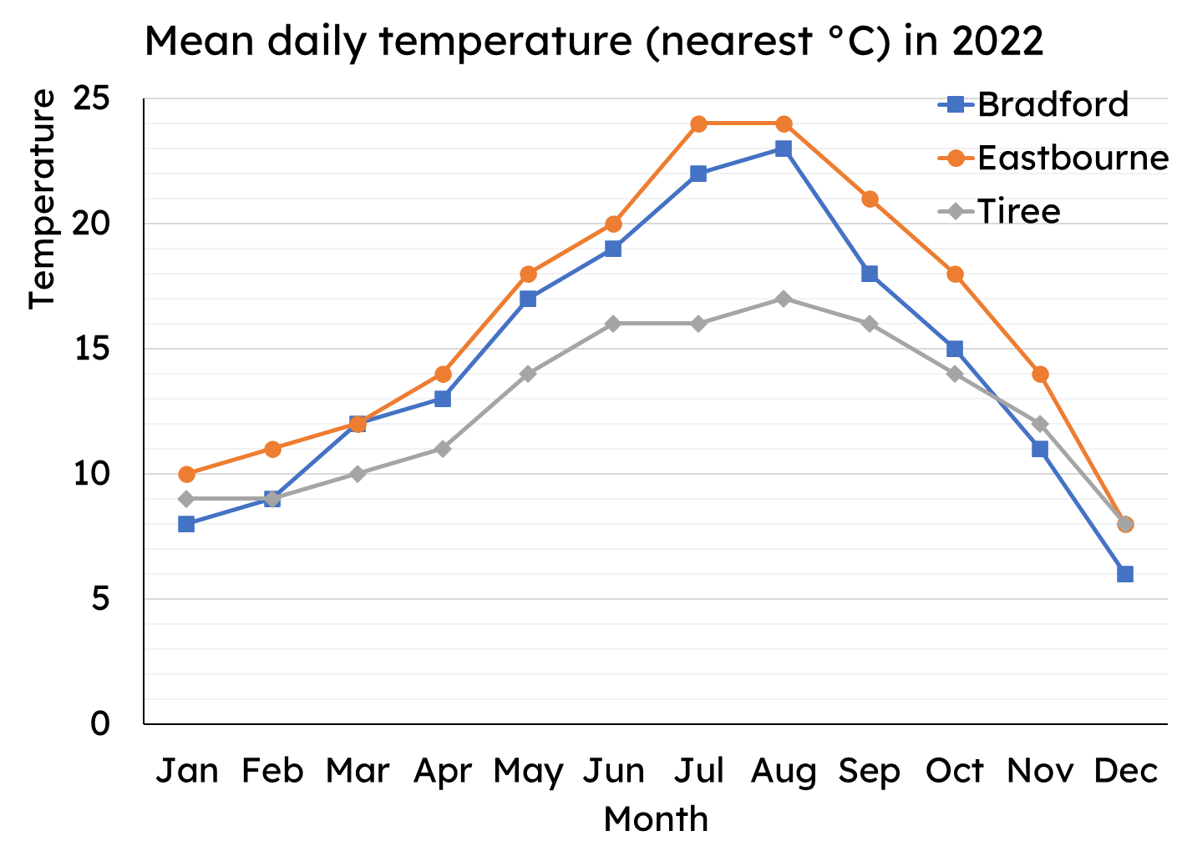
Calculating the mode
Task B: Mode from bar charts
What is the mode on each of these bar charts?
a)
b)
Carriage 1
Size 4
The data is bimodal. Complete the bar chart.
Bimodal means it has two that appear the most, more than any others.
100 pieces of data are represented on a bar chart. The data is bimodal. Add the two missing bars.
Task C: Mode from line graphs
What is the modal temperature for each place?
Bradford - no mode
Eastbourne - trimodal
14°C, 18°C and 24°C
Tiree - bimodal 9°C and 16°C
Mathematics In Education and Industry

